Slide 1







Generating video game quests from stories
START
Manish Kumar Mishra
Committee: Dr. Lorenzo Gatti, Dr Faiza A. Bukhsh
Notes:
Good afternoon, everyone! Welcome to my master’s thesis defence where I present my work on the topic
¶ “Generating video game quests from stories”. First, I want to thank my supervisors – Lorenzo and Faiza for their support and guidance throughout this project. Let’s get started

Slide 2


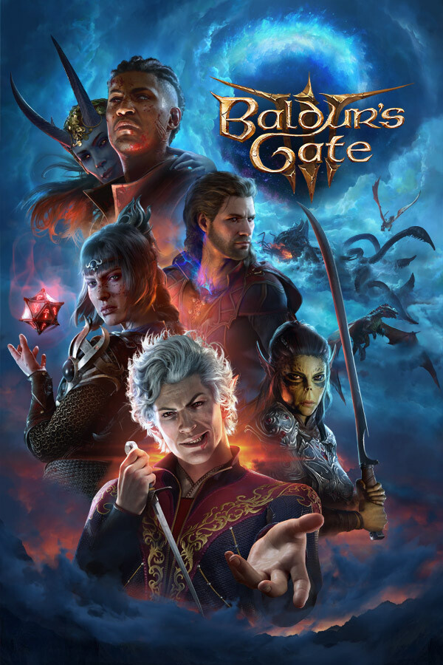

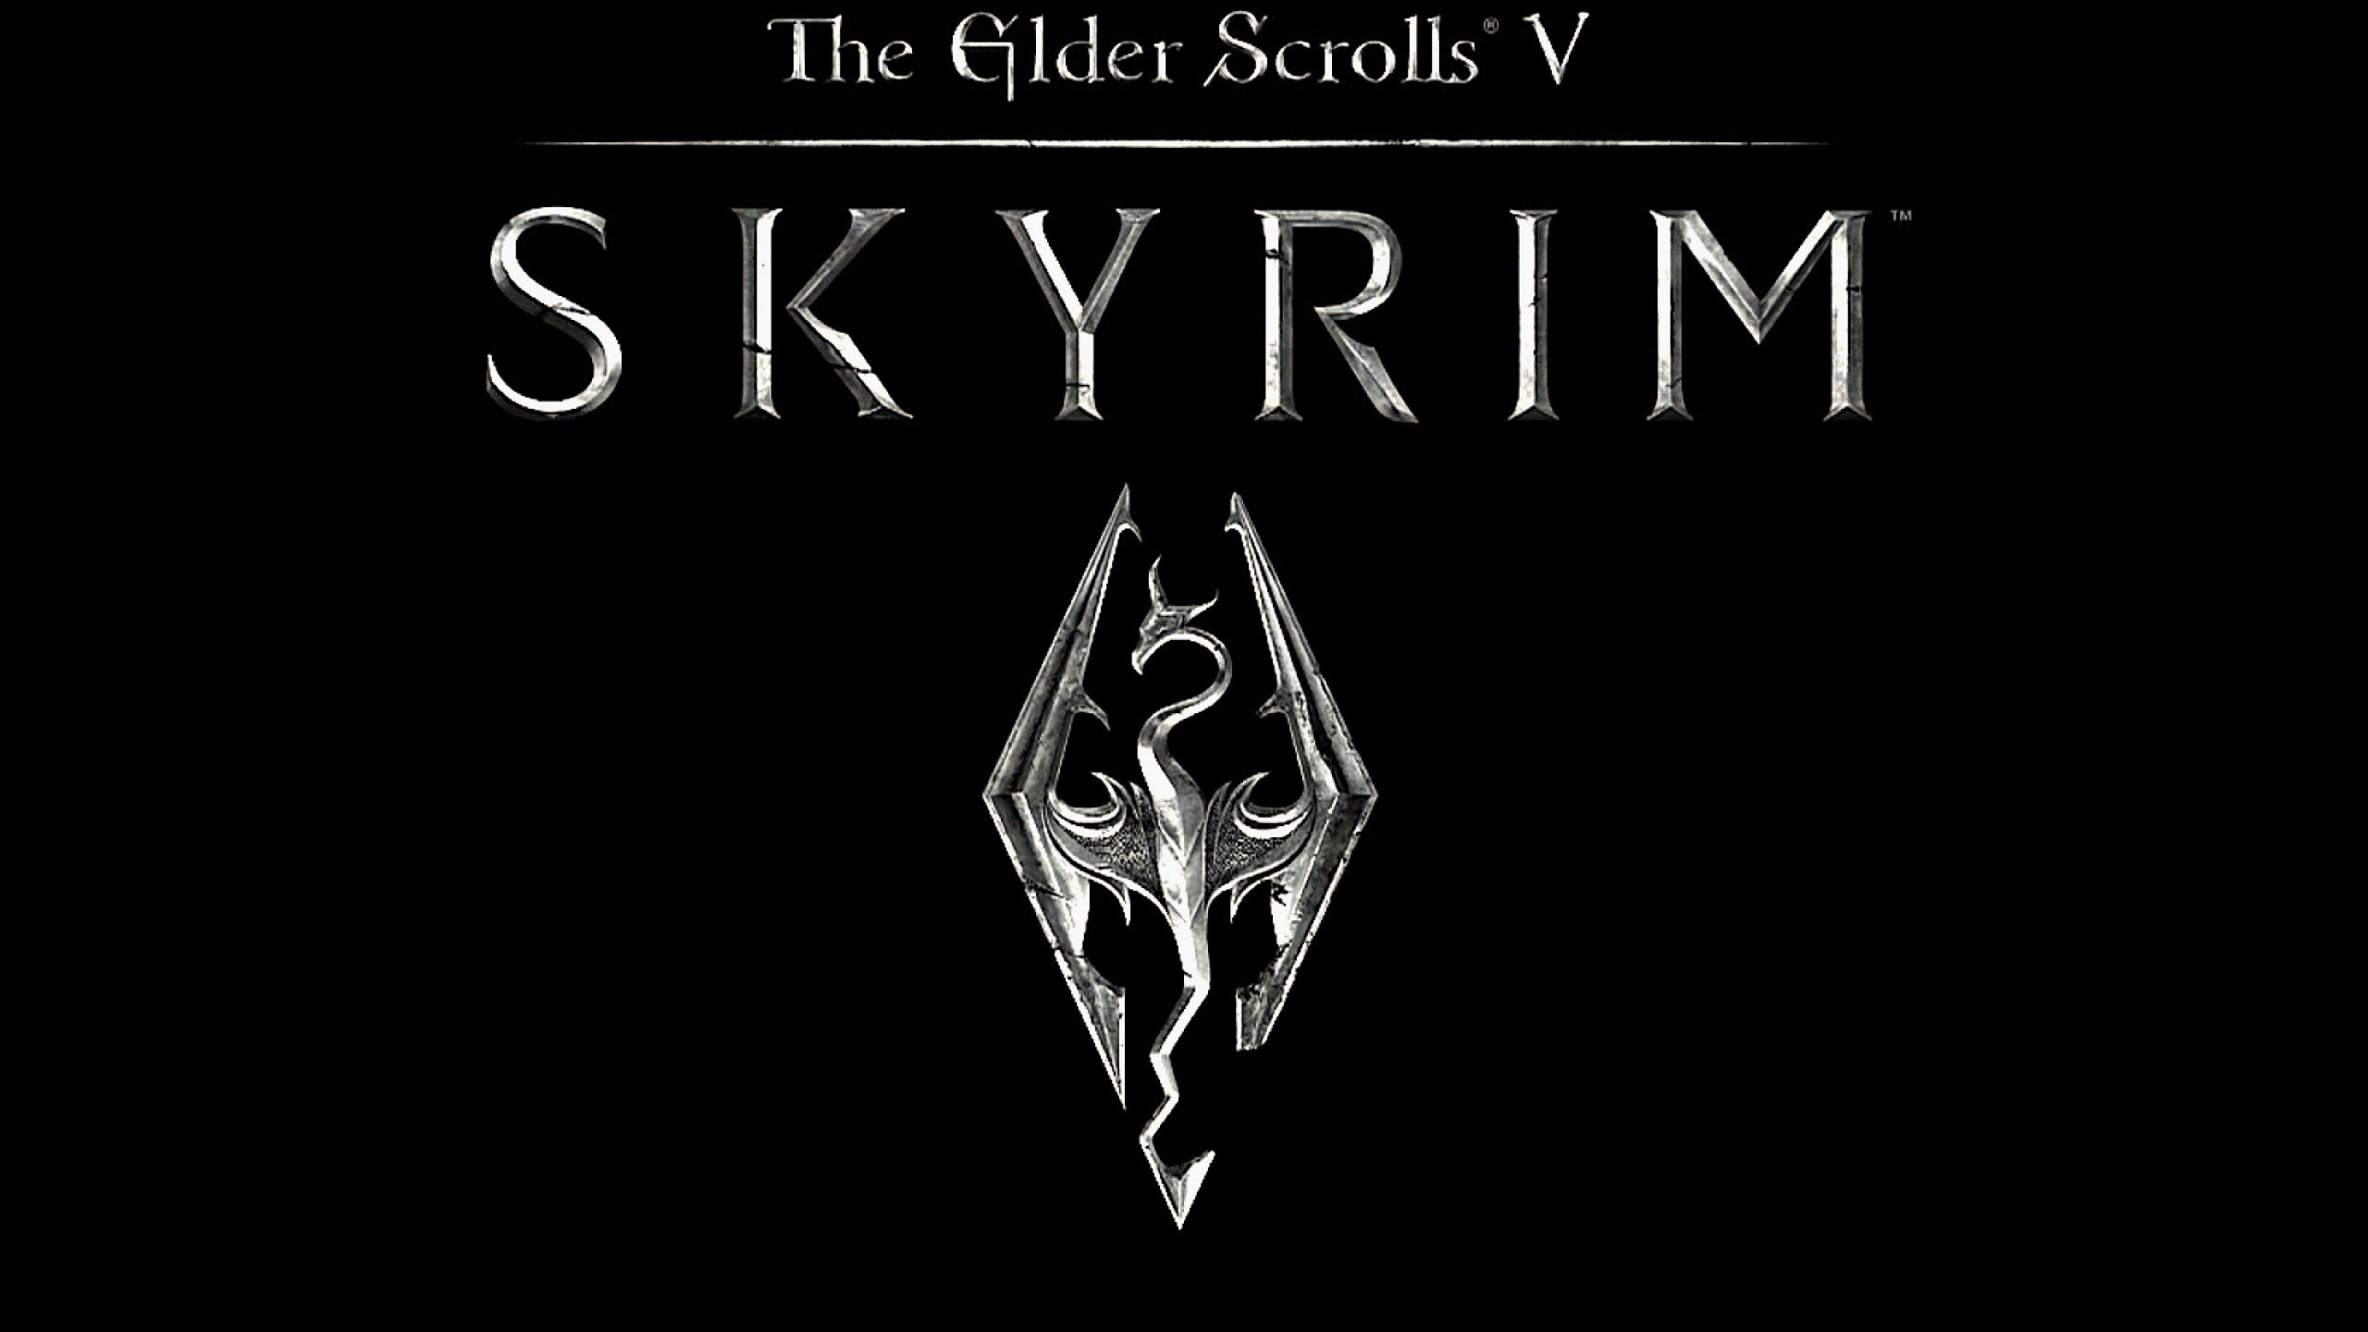
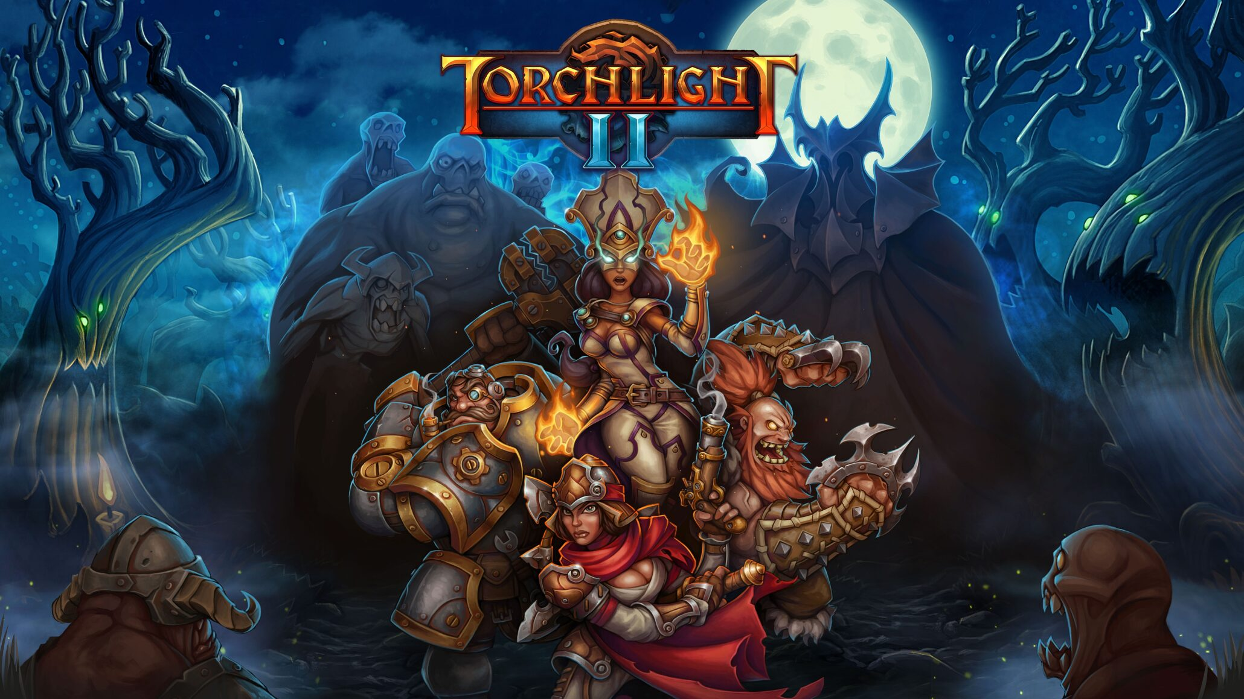
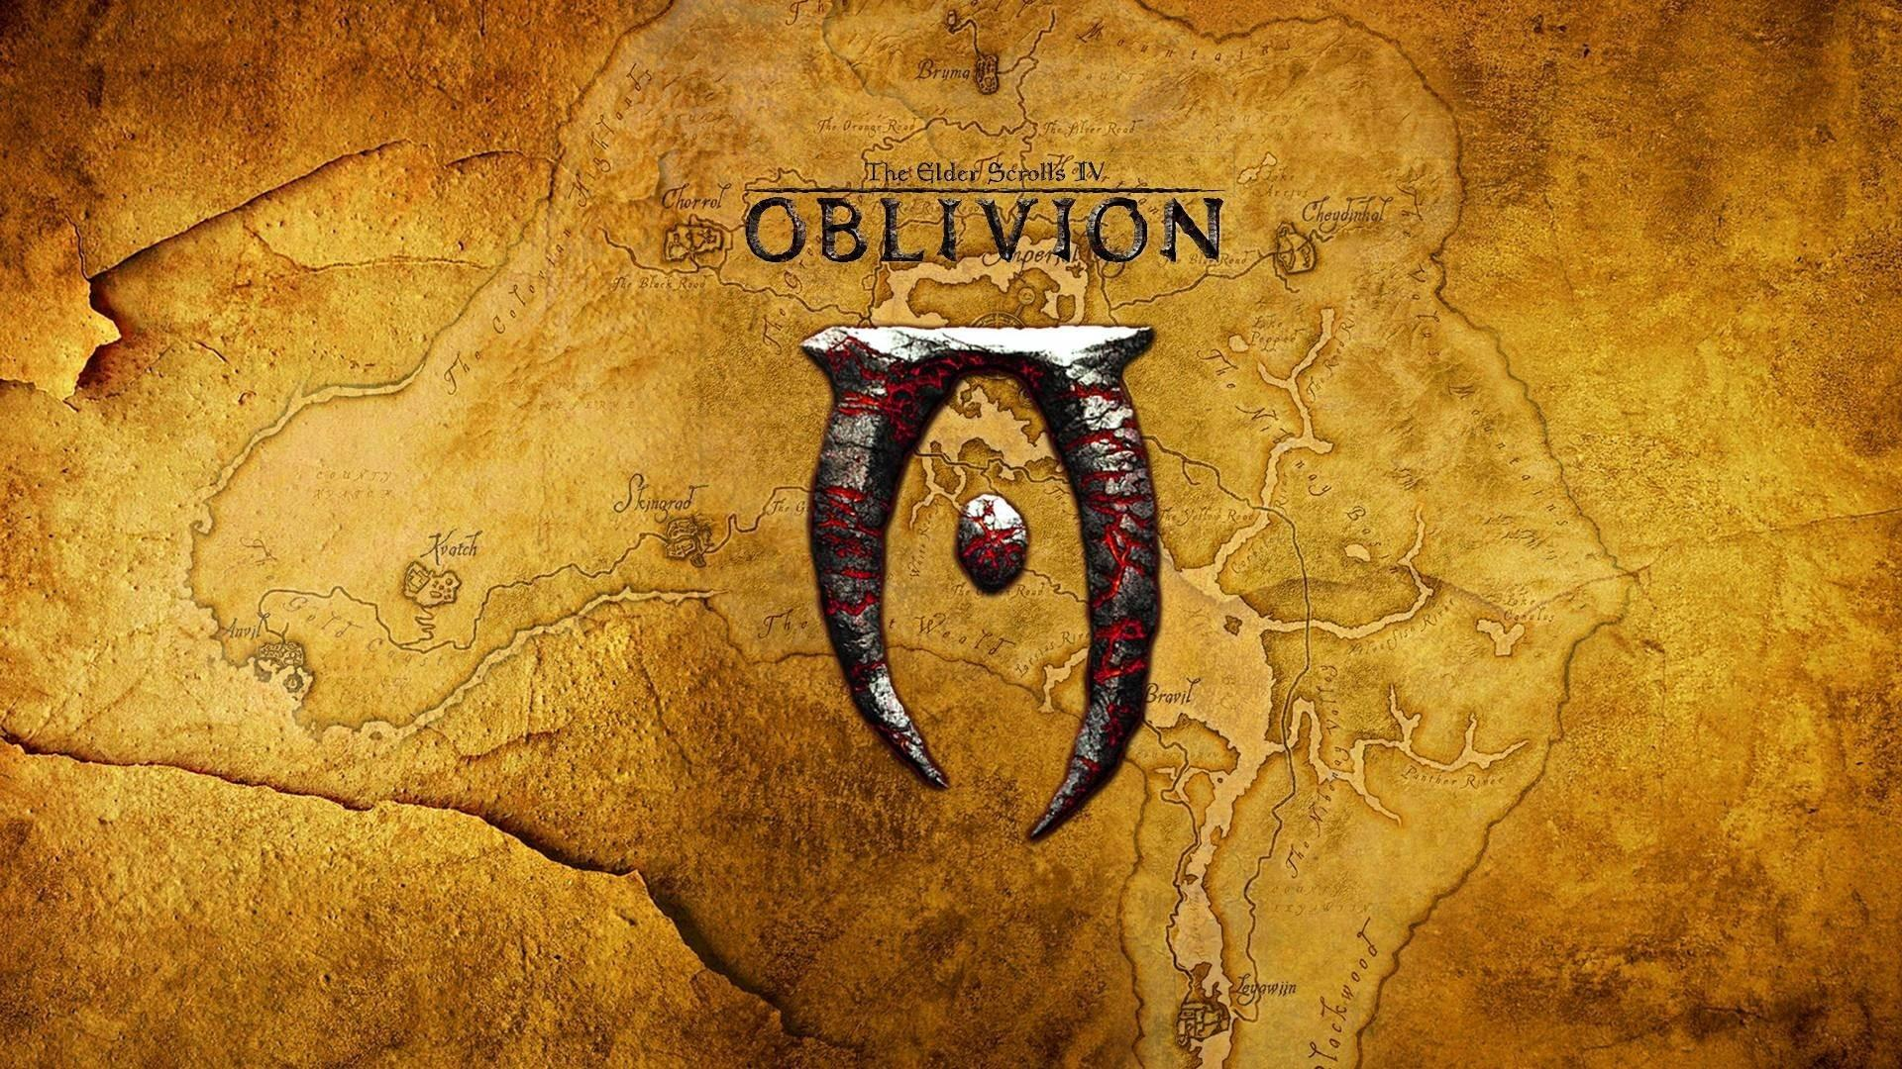

Video games
1
Notes:
Do any of you know which game won the game of the year 2023?
¶ That’s right, Baldur’s Gate 3 won the award. Baldur’s gate 3 is a role-playing game or RPG for short, and it features an intriguing story for the players to explore.
Other similar story-based games have risen in popularity,
¶ like the previous Baldur’s Gate games, Torchlight and the Elder Scrolls games. An enticing thing about these games is that it allows players to take part in quests to tell the story. In these games, when the player approaches non-playable characters in the game, they provide a background story and a quest related to the story.

Slide 3

Quests
To progress the story
Title:
Help Korgan Recover the Book of Kaza
Objective:
bring the Book of Kaza to the book collector
Tasks:
- Head to a tomb over in the lower crypts of the Graveyard District
- find the Book of Kaza with Korgan Bloodaxe
2
Notes:
These quests allow the player to interactively progress through the story of the game. People who have played video games before might know how a quest is structured.
¶ Taking an example from Baldur’s Gate 2, this quest has
¶ the title,
¶ the main objective, and
¶ the list of tasks which the player must finish. Most games follow the same structure for quests, and this project will use the same. But designing quests that align well with the game’s plot is a challenging job.

Slide 4



LLMs
ChatGPT (OpenAI)
🦙
BERT (Google)
Llama2 (Meta)
3
Notes:
Nowadays, large language models (or LLMs) have become very popular because of their capabilities in generating text. These models generate responses based on an input from the user, which are commonly known as prompts.
¶ We all know and love ChatGPT, which seems to have the answer to everything. Some other LLMs include
¶ Llama2 by Meta, and
¶ BERT by Google. With the capabilities of such LLMs, they can have an intuitive application in generating quests.

Slide 5









Opportunity
LLMs & game text generation
Create a quest generation framework using modern LLMs
Assess the impact of including world knowledge in quest generation from story plots
Use obsolete techniques
Focus on generating other text in games
Do not use world knowledge
4
Notes:
There are some existing approaches which use LLMs for video game text generation, but they
¶ use older obsolete techniques, or
¶ focus on generating other kinds of texts such as character dialogues and descriptions.
¶ Moreover, most of the existing methods do not use the world knowledge that can provide contextual information related to the narratives. This opens an opportunity for this project to
¶ create a framework which can generate quests from story elements using modern LLMs, and
¶ use the world knowledge from the narratives as contextual information

Slide 6










Story
plot points
A set of entities – characters, locations and objects
5
Notes:
With the quest generation framework, we want to use the story elements to generate quests. But what are the story elements?
¶ A story can be considered as a sequence of events or plot points. These plot points serve as the main representation of the narrative flow of the story.
¶ Information about the story entities in the narrative world – which are the characters, locations and objects - provide further contextual information related to the plot points.
¶ To get the complete information about these entities, the relations between them also needs to be captured.

Slide 7
Knowledge Graphs
A set of entities – characters, locations and objects
A powerful warrior
A man
Korgan Bloodaxe
Book collector
Giving world knowledge
held by
Tomb over in the lower crypts of Graveyard district
Book of Kaza
present in
grimoire
6
Notes:
To represent the relations between the entities, knowledge graphs are used. Knowledge graphs are web like data models containing nodes and edges. The nodes represent entities, in this case
¶ the characters, shown in blue;
¶ the locations, in green; and
¶ the objects, in red. Along with the nodes, a knowledge graph also contains edges. The edges represent the relations between these entities.
¶ These knowledge graphs provide the contextual world knowledge of the narrative.

Slide 8
Story, Quest and KG
plot points
Sequence of events or plot points
Story
characters, locations and objects
A set of entities – characters, locations and objects – related to the narrative
(a) nodes = entities
Knowledge Graph
(b) edges = relations between entities
Quest
A title, a main objective and a set of tasks to progress through the
7
Notes:
So far, we have identified what a
¶ story is – it is a sequence of events that affect the entities – the characters, locations and objects in the narrative.
¶ a knowledge graph is a data model, where nodes represent the entities and the edges or the connections between them are the relations between these entities
¶ a quest in a video game - is a way of progressing the narrative, containing a title, a main objective and a set of tasks to progress through the plot points.

Slide 9



Quest generation framework
Plot points related to the quest
Contextual information from the world knowledge graph
Quest generation language model (LLM)
8
Notes:
Using this information, the quest generation framework of this project works with three elements:
¶ Quest plot points as the primary input
¶ World knowledge (as knowledge graph) as contextual input and the
¶ Quest generation model.

Slide 10

Dataset
Quests dataset provided by Värtinen et al.
9
Notes:
The dataset used in this project contains quests from the five story-based video games mentioned at the beginning as well as from Minecraft.

Slide 11
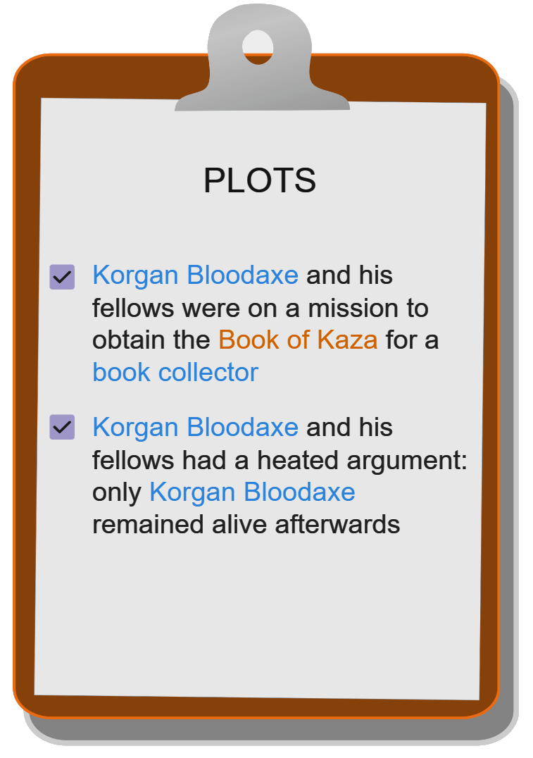
Dataset
Quests dataset provided by Värtinen et al.
Help Korgan Recover the Book of Kaza
Description:
A powerful warrior
A man
Title:
“I'm scouring for a band of desperate adventurers to aid me in a gallant task. Come and hear Korgan Bloodaxe's tale!
…
Well... it'll take far more than a few shambling bags of skin and stitches to deter Korgan Bloodaxe from a king's ransom! A foolhardy jaunt into a hive of undead? How could ye resist??
Plot points:
Entities:
Korgan Bloodaxe
Book collector
Objective:
bring the Book of Kaza to the book collector
Tasks:
- Head to a tomb over in the lower crypts of the Graveyard District
- find the Book of Kaza with Korgan Bloodaxe
Book of Kaza
Tomb … district
grimoire
10
Notes:
This dataset contains 4 important pieces of information:
¶ the quest with the title, objective and the list of tasks
¶ the quest description which gives the background story for the quest
¶ the plot points related to the quest, and
¶ the set of entities related to the quest, along with some description for each entity. However, the quest generation framework needs the world knowledge as a knowledge graph.

Slide 12
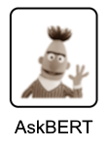
Dataset
Quests dataset provided by Värtinen et al.
Entities:
Book of Kaza
Korgan Bloodaxe
Book collector
Tomb over … district
Relation extraction questions
A powerful warrior
A man
Korgan Bloodaxe
Book collector
Description:
“I'm scouring for a band of desperate adventurers to aid me in a gallant task. Come and hear Korgan Bloodaxe's tale!
…
Well... it'll take far more than a few shambling bags of skin and stitches to deter Korgan Bloodaxe from a king's ransom! A foolhardy jaunt into a hive of undead? How could ye resist??
held by
Book of Kaza
Tomb over in … district
present in
grimoire
Quest knowledge graph
11
Notes:
So, this dataset was improved by constructing the world knowledge graphs for each of the game in the dataset. To do this,
¶ the AskBERT model is used – which is a customized BERT language model which can answer questions from a given text. To extract the relations, and construct the knowledge graph,
¶ the quest description is provided as the main input text to the AskBERT model and
¶ relation extraction questions are asked as the input prompt. This is done
¶ for each entity for each quest to extract every relation for that entity. An example question to get the location of the object Book of Kaza would be such as “Where is Book of Kaza located in the story?” as the input prompt.
¶ The knowledge graphs are extracted for every quest and all the quest-level knowledge graphs for a particular game are combined to get a world knowledge graph for each game.

Slide 13

Final dataset
Quests dataset provided by Värtinen et al.
plot points
game knowledge graph
actual quests
12
Notes:
The final dataset is an improved version of the original dataset, which now includes the world knowledge graph for each game. With this, we finally have all the input elements for the quest generation framework:
¶ the plot points, and
¶ the knowledge graph.
¶ the desired quest output is also present, which is used to customize the quest generation model to produce quests from these inputs.

Slide 14


Quest generation model
🦙
text input
🤗Llama 2 13B HF
text output
13
Notes:
Which brings us to the quest generation language model. For this,
¶ Llama2-13B model is used. Llama2 is a state-of-the-art large language model by meta.
¶ Llama2 is a text generation model and requires text input prompts to generate output.

Slide 15
World knowledge as text
character
location
object
A powerful warrior
Korgan Bloodaxe is a powerful warrior.
Korgan Bloodaxe is a character.
A man
Korgan Bloodaxe
Book collector
A tomb over in the lower crypts of the Graveyard District is a location.
Book of Kaza is a grimoire.
Book of Kaza is a object.
held by
Book of Kaza is held by Korgan Bloodaxe.
Book of Kaza
present in
Tomb over in … district
Book of Kaza is present in a tomb over in the lower crypts of the Graveyard District.
grimoire
Book collector is a man.
Book collector is a character.
Knowledge graph
Text format
14
Notes:
For this reason, the information in the
¶ knowledge graph was converted into text format which Llama2 can understand. For this, the knowledge graph relations are converted into textual descriptions
¶ in this way – first the description, then the type, then all the relations from the entity is formatted

Slide 16
Input for fine-tuning
### Background:
KG in text format
…
…
### Plots:
plot points
…
The quest related to the above information is as follows:
### Quest:
Title: …
Objective: …
Tasks:
…
quest
### End
15
Notes:
Now that there’s the mechanism to convert KG to text and that plot points are in text format, the input prompts to fine-tune Llama and get the outputs needs to be constructed. The input to the model is delimited using section headers or tags, each signifying one part of the input.
¶ First comes the background information section with the background tag.
¶ This section contains the knowledge graph information converted to text.
¶ Then the plots section
¶ which contains the list of plot points.
¶ After that, the quest generation prompt “The quest related to the above information is as follows:” is put,
¶ followed by the quest tag,
¶ then the quest itself.
¶ Finally the end tag is added. To fine-tune the model,
¶ the whole input is passed. Llama2 is a text completion model and therefore learns to generate text according to the structure we provide.
¶ For generation, the input is till the quest generation prompt and the model generates the quest followed by the end tag.

Slide 17
Varying amounts of contextual information
3
0
2
KG_DEPTH
1
🦙
plot points
KG2Text model
Baseline model
16
Notes:
With the first sub-research question, we want to assess how similar the generated quests are with varying amounts of contextual information. For this, the language model is finetuned to generated quests by using knowledge grounded inputs – meaning inputs with relevant information added. A controllable depth parameter was used to change the amount of background information from the world knowledge called
¶ KG DEPTH.
¶ At depth 0, no world information was added – generating quests from plot points alone. This is called the baseline model.
¶ At level 1, all the entities mentioned in the plot point and their direct relations are added.
¶ At higher levels, the nodes at the depth’s distance from the mentioned entities in the graph are added.
¶ The maximum that was used for this project was depth level of 3. These are the KG2Text models.

Slide 18

Final framework
🦙
Baseline model
plot points
generated quest
🦙
plot points
KG2Text models
generated quest with world knowledge
17
knowledge as text
Notes:
Moving on to the second sub-research question, to evaluate the impact of adding world knowledge on the quality of quests generated from story plot points. For this, the outputs from
¶ the baseline model and
¶ the KG2Text models. Some of the generated outputs were compared by participants in an online survey.

Slide 19
Aim
✅
Create a quest generation framework using modern LLMs
Assess the impact of including world knowledge in quest generation from story plots
Analyze how varying the amount of included world knowledge affects the similarity of generated quests with the actual quests
Examine the quality of quests generated with and without inclusion of world knowledge
18
Notes:
At the beginning, we saw the opportunity to create a quest generation framework using modern LLMs. This framework uses the contextual world knowledge and the story plots to generate quests.
¶ Next, to assess the impact of including world knowledge we:
¶ compare the generated quests with the actual quests and get a similarity score. The actual quests are considered as the gold standard quests, and the quest generation model is fine-tuned to generate quests as close as the actual quests as possible.
¶ We also examine the quality of the generated quest, by asking participants to rate some of the generated quests.

Slide 20
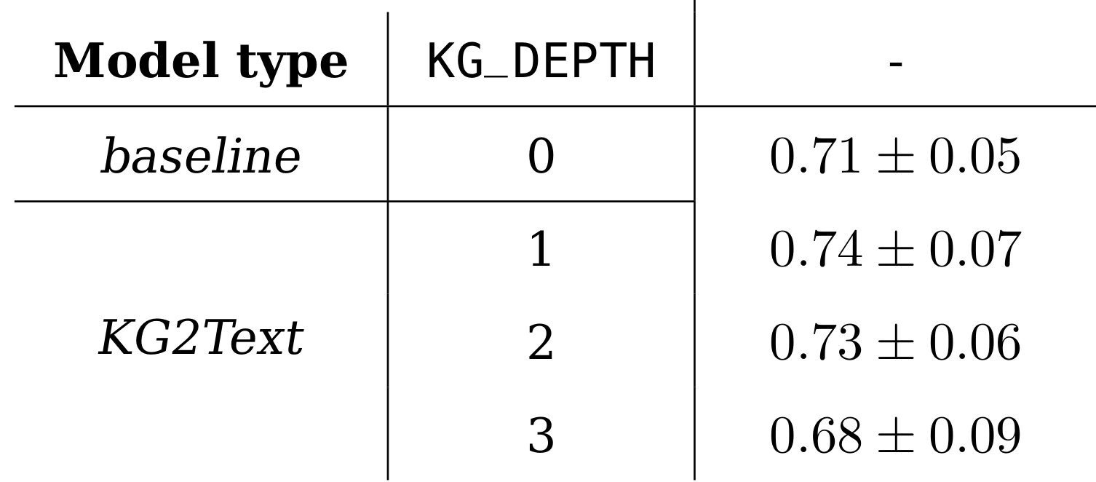

Measuring similarity
BERTScore
BERTScore
actual quests vs
✅
With KG_DEPTH = 1, generated quests are most similar to actual quests
19
Zhang, T. et al. (2020) ‘BERTScore: Evaluating Text Generation with BERT’. arXiv. Available at: https://doi.org/10.48550/arXiv.1904.09675 .
Notes:
To answer the first sub-research question, we compared the outputs from them models at different KG_DEPTH values with the actual quests. As the actual quests are the human written ones found in the game, it is treated as the gold standard for the models to generate. To compare,
¶ BERTScore was used. This metric provides scores which tell us how alike two texts are. A score of 0 means that the texts are completely different, whereas 1 means that the texts are identical. BERTScore uses the BERT language model to compare and calculate the similarity scores between two input texts.
¶ These are the BERTScore values comparing the outputs to actual quests.
¶ We can see that at KG depth 1, the generated quests are the most similar to the actual quests.

Slide 21

AI Quest generation survey
Assessing quality
Examine the quality of quests generated with and without inclusion of world knowledge
Background story
Quest generated without world knowledge (No KG quest)
Quest generated with world knowledge (KG quest)
Which quest suits the story better?
Rate the quests on a 5-point scale
On Microsoft Office Forms, distributed over University study groups, gaming Discord servers and Reddit communities
20
Notes:
The second aim of our project was to
¶ examine the quality of quests generated with and without world knowledge. For this, an online survey was put out in which the participants were requested to rate the generated quests. The survey consisted of 10 questions. For each question, the participant was first shown
¶ the background story, followed by two quests.
¶ one of these were generated without the inclusion of world knowledge and the other with this knowledge.
¶ Then the participants were asked to pick the quest that suited the story better.
¶ finally, they were asked to rate each of the quests based on 4 criteria, on a 5-point Likert scale.

Slide 22


AI Quest generation survey
Examine the quality of quests generated with and without inclusion of world knowledge
Relatedness: “The quest is related to the given story"
Contradiction: "The quest contains contradictory statements with respect to the story shown"
Coherence: "The quest follows the shown storyline consistently”
Value: "The quest contributes to progressing further in the given story"
On Microsoft Office Forms, distributed over University study groups, gaming Discord servers and Reddit communities
21
Notes:
The criteria were as follows:
¶ Relatedness - Evaluating if the quest is relevant to the provided story – ¶ higher agreement score is better
¶ Contradiction - Determining if the quest contains statements that contradict the story – ¶ lower agreement score is better
¶ Coherence - Assessing the consistency of the quest with the storyline – ¶higher agreement score is better
¶ Value - Judging the quest's alignment to the story plot progression – ¶ higher agreement score is better
A total of 22 responses were considered for evaluation.

Slide 23
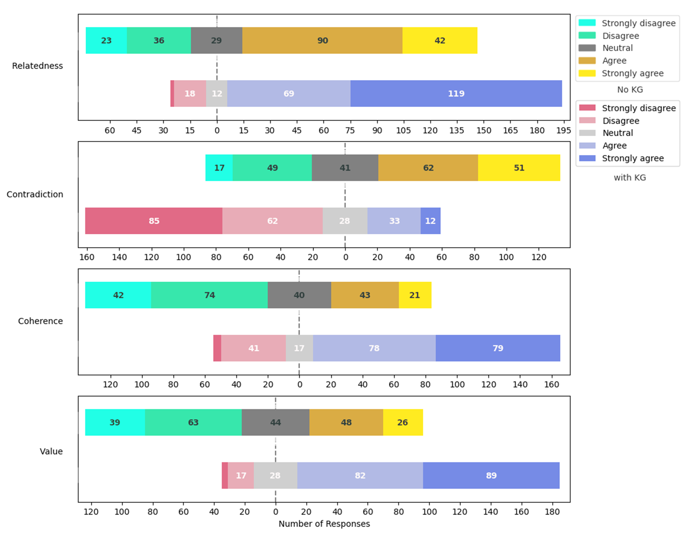
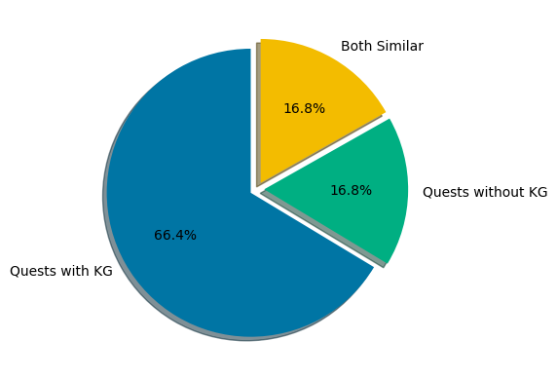
Survey results
Rating distributions
Quest preference
22
Notes:
The results of the survey are as follows:
¶ When asked for their choice, 66.4% of the time the KG2Text quest were preferred by the participants. 16.8% preferred the quests generated without KG and the remaining 16.8% found both the quests similar.
¶ Coming to the criteria rating – for each criteria, the top bar shows the distribution for the quests generated without world knowledge and the bar below shows the ratings for the other quest. The participants mostly strongly agree that the KG quests are related to the story vs mostly agree for No KG quests. For contradiction, participants found that the No KG quests are more contradictory vs the KG quests. Even for coherence and value, the participants favour the KG quests over No KG.

Slide 24
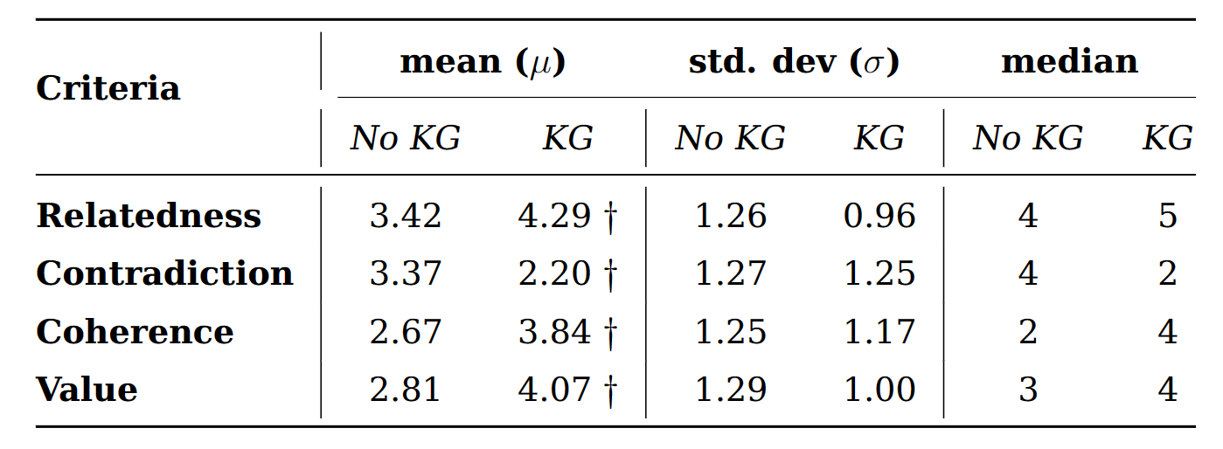
Survey results
† indicates a significant difference
1 – Strongly disagree
2 – Disagree
3 – Neutral
4 – Agree
5 – Strongly agree
✅
Including world knowledge results in generated quests being perceived more related and coherent, less contradictory and aligning better to story progression value.
23
Notes:
To confidently assess conclude the quality difference, a statistical significance test was conducted.
¶ We find that the quest generated with the inclusion of world knowledge are perceived to be more related
¶ less contradicting
¶ more coherent, and
¶ contributing more to the story progression value.
¶ these results indicate a strong preference for quests generated with world knowledge over those without.

Slide 25
Conclusion
Impact of including world knowledge in quest generation from story plots
✅
Including world knowledge improves the perceived quality of generated quests.
✅
Including information about entities directly mentioned in the related plot points produce quests that are most similar to actual quests.
24
Notes:
Together with the BERTScores and survey results,
¶ we can say that the integration of world knowledge improves quests generation from story plots in terms of relatedness, coherence, contradiction and progression value to the story. Moreover, including information from the world knowledge graph for the entities directly mentioned in the plot points generates the quests which are most similar to the actual quests found in game.

Slide 26
Contributions
1. A systematic and reproducible quest generation framework
🦙
2. An updated version of quests dataset, which now includes the game world Knowledge graphs.
A powerful warrior
A man
Help Korgan Recover the Book of Kaza
Book collector
quests
Korgan Bloodaxe
plot points
bring the Book of Kaza to the book collector
held by
knowledge graph
- Head to a tomb over in the lower crypts of the Graveyard District
- find the Book of Kaza with Korgan Bloodaxe
Book of Kaza
Tomb over in … district
present in
plot points
actual quest
grimoire
A tomb
25
Notes:
The work done in this thesis has two major contributions.
¶ A systematic and reproducible quest generation framework which can utilise a state-of-the-art LLM to generate quests from story plot points, and varying levels of world knowledge.
¶ and second, an updated quests dataset which includes the game world knowledge graph.

Slide 27
Limitations
1. BERTScore
✔️Similarity
❌Quality
2. KG2Text
A powerful warrior
A man
Korgan Bloodaxe is a powerful warrior.
Korgan Bloodaxe is a character.
Korgan Bloodaxe
Book collector
A tomb over in the lower crypts of the Graveyard District is a location.
held by
Book of Kaza is a grimoire.
Book of Kaza is a object.
Book of Kaza is held by Korgan Bloodaxe.
Book of Kaza
Tomb over in … district
Book of Kaza is present in a tomb over in the lower crypts of the Graveyard District.
present in
Book collector is a man.
Book collector is a character.
A tomb
grimoire
26
Notes:
There were some limitation in this project.
¶ Although the BERTScore used tells us how
¶ similar the generated quests are to the actual quests,
¶ It does not tell us anything about the quality of the quests. We treat the actual quests as the baseline gold standard for our quest generation framework. So, we can say that setting KG_DEPTH to 1 does not indicate the best quality quests among the generated ones, rather, the most similar to the actual quests.
¶ Another limitation is the way knowledge graph data is incorporated. We convert the data into textual descriptions as the Llama2 model can only understand text data. However, adding graph layers to the LLM require intensive further training and can be a considered as a potential future improvement to the project.

Slide 28
Future work
1. Automatic extraction of plot points and world knowledge graph
story
extraction model
plot points
knowledge graph
2. Dynamic approach to recording game world changes to create quests on-the-fly
27
Notes:
There are a few other ways that this thesis can be extended,
¶ The quest generation framework can generate individual quests from a set of already extracted plot points and world knowledge. It can be extended to extract story plots and the world knowledge graph directly from a given narrative
¶ Another extension would be a dynamic approach to recording the game world could be explored to create run-time on-the-fly quest generation based on the current state of the narrative flow and world entities.

Slide 29
Recap
🦙
✅
Create a quest generation framework using Llama2
✅
Assess the impact of including world knowledge in quest generation from story plots
✅
Analyze how varying the amount of included world knowledge affects the similarity of generated quests with the actual quests
✅
Examine the quality of quests generated with and without inclusion of world knowledge
28
Notes:
To recap,
¶ we found the opportunity to create quest generation by using modern LLMs, story plots and world knowledge.
¶ We used our quest generation framework to generate quests from plot points and including world knowledge.
¶ We found that including information about the entities directly mentioned in the plot points produce the quests most similar to the actual quests.
¶ These quests are also perceived to be better than the quests generated without any world information.

Slide 30




Thank you!
Notes:
Thank you

Slide 31

Research questions
[RQ1] - How does the integration of world knowledge affect the quality of quest generation using LLMs from narrative plot points?
[RQ1.a] - How similar are the quests generated with varying amounts of contextual information provided by world knowledge?
[RQ1.b] - What effect does incorporating knowledge from knowledge graphs into LLMs have on improving the quality of generated quests in terms of story relatedness, coherence, contradiction and progression value?
18

Slide 32
Outputs
Quest without KG
Title: The book of kaza
Objective: Bring korgan bloodaxe's head to the book collector
Tasks:
Travel to solitude.
Find korgan bloodaxe
Quest with KG
Title: The book of kaza
Objective: Get the book of kaza
Tasks:
Reach a tomb over in the lower crypts of the graveyard district.
Actual quest
Title: Help korgan recover the book of kaza
Objective: Bring the the book of kaza to the book collector
Tasks:
Head to a tomb over in the lower crypts of the graveyard district.
Find the book of kaza with korgan bloodaxe
3

Slide 33




Now we wait

Slide 34
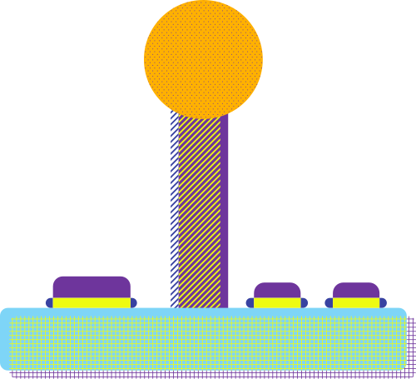

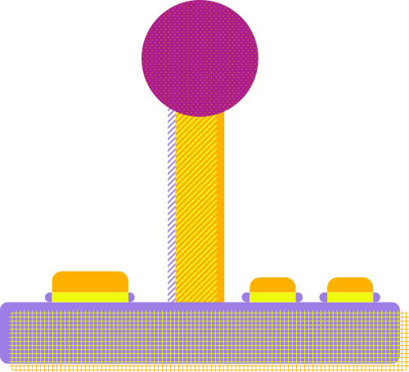
Introduction
Notes:
So, let’s get started

Slide 35



Framework design
Notes:
Let’s see the design

Slide 36
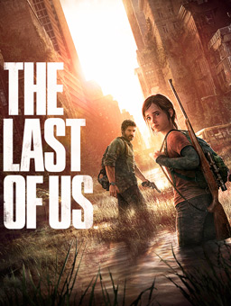


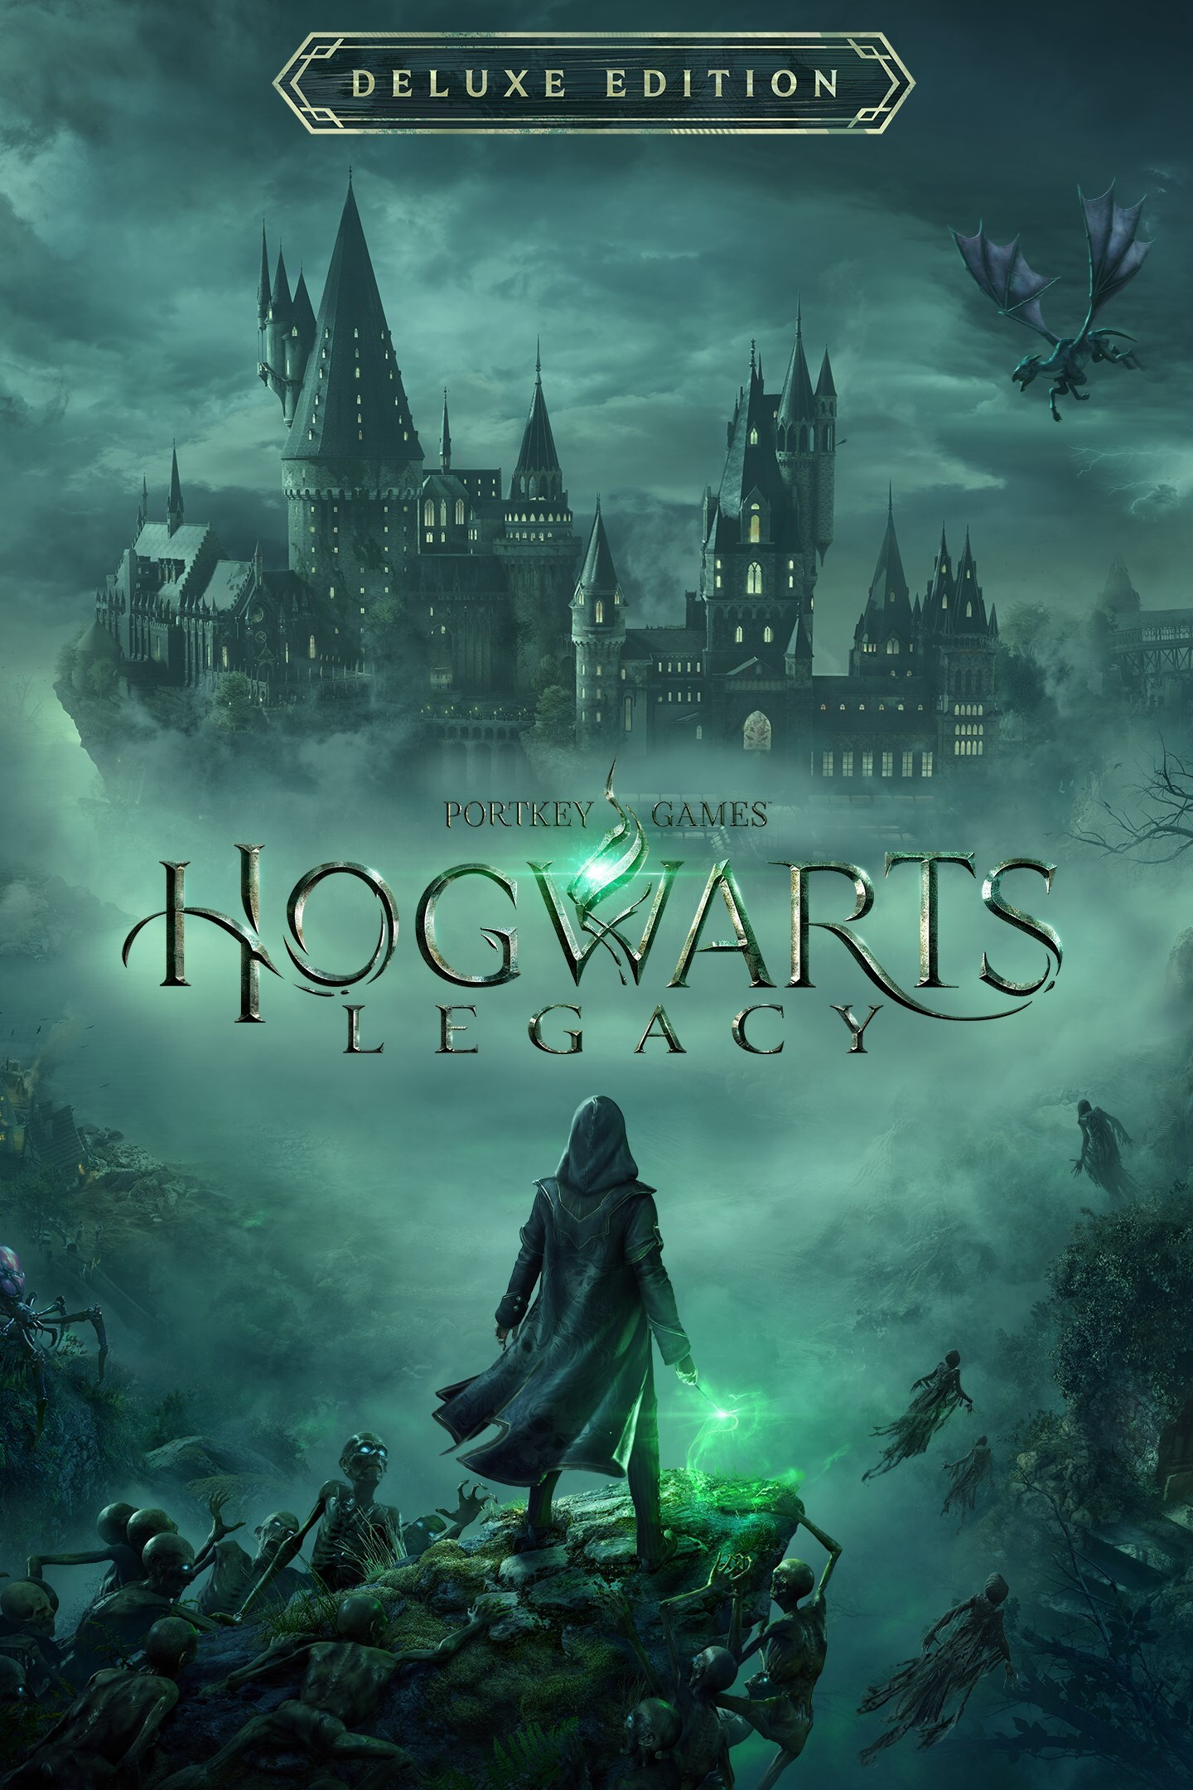
Designing quests
Designing quests
Quests or missions
3
Notes:
Developing video games is a really challenging process and requires a lot of effort – not only in coding, but also in the creative processes of designing the interactive experiences in general.
¶ Most video games based on a story feature quests or missions that narrate the story in parts

Slide 37
Natural Language Generation
Language Model
Fine-tuned Language Model
Curated dataset
Fine-tuning
3
Notes:
But these LLMs are far from being perfect when it comes to providing accurate information, often producing incorrect answers and hallucinating with facts. So how to make these language models produce correct outputs? The most common way is by making the models learn how we want the output to be, from existing data.
¶ This process is called fine-tuning, and it is a standard process in many AI related applications. During fine-tuning, the model’s behaviour is updated to learn and generate correct facts by giving it information related to the task at hand. In this project, the task at hand is quest generation from stories.

Slide 38
Implementation details
Notes:
Now, it is time to get into the technical details of the quest generation framework, beginning with the dataset used.

Slide 39
Experiments & Results
Notes:
So, let’s go over the results of these experiments.

Slide 40



Conclusions
Notes:
Finally, lets wrap up

Slide 41

Agenda
Elaborate on what you want to discuss.
1
2
3
Introduction
Our Process
About Us
Elaborate on what you want to discuss.
Elaborate on what you want to discuss.

Slide 42

Implementation details
Notes:
Now, we get into the technical details of the quest generation framework along with the dataset used.

Slide 43




Add a Timeline Page
Add a main point
Add a main point
Add a main point
Add a main point
Elaborate on what you want to discuss.
Elaborate on what you want to discuss.
Elaborate on what you want to discuss.
Elaborate on what you want to discuss.

Slide 44


Our Services
Service One
Service Two
Elaborate on what you want to discuss.
Elaborate on what you want to discuss.
Service Three
Service Four
Elaborate on what you want to discuss.
Elaborate on what you want to discuss.

Slide 45
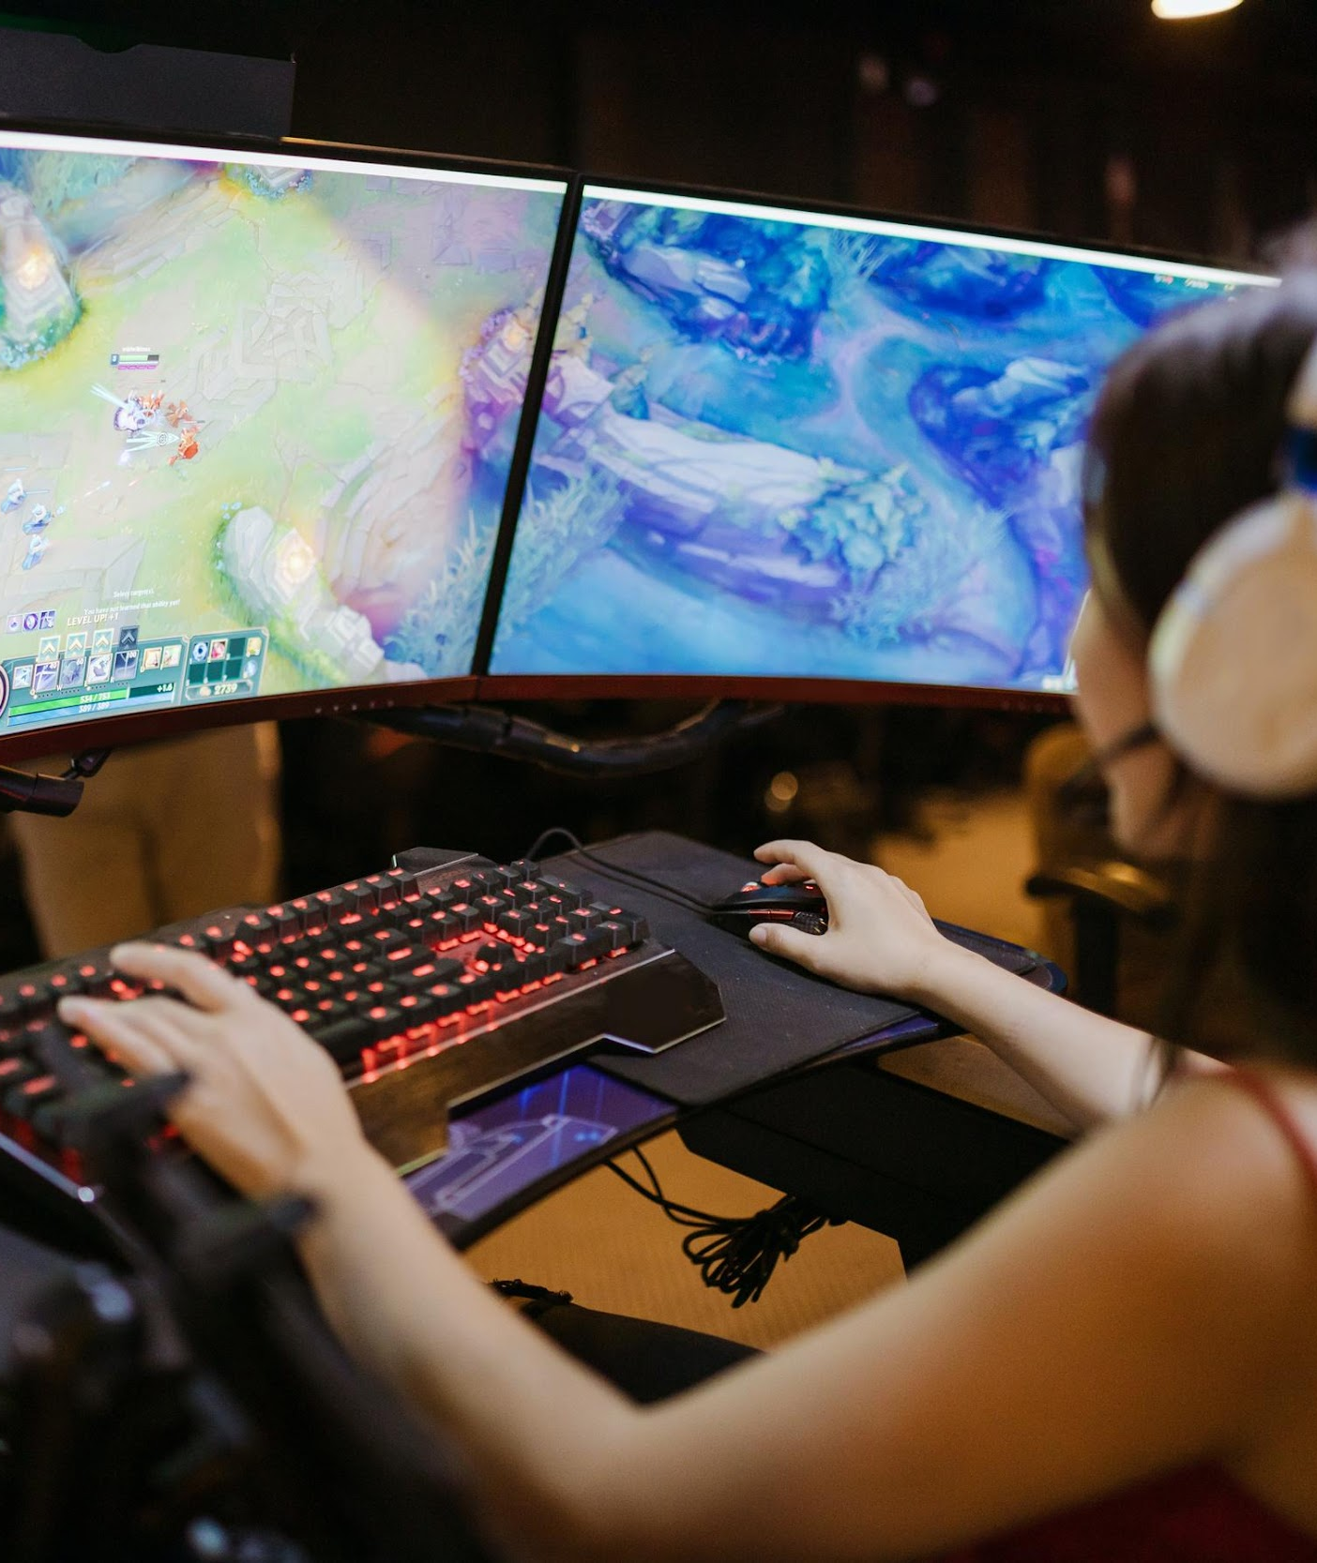
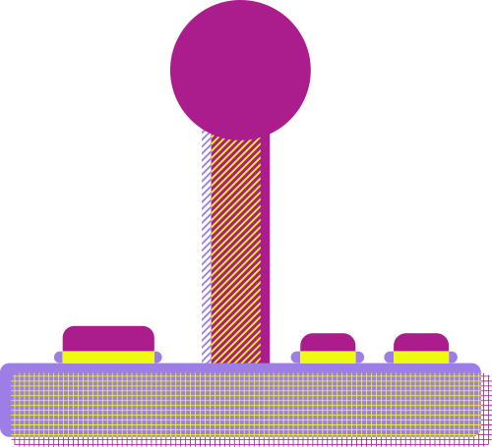
Your Project
Presentations are communication tools that can be used as demonstrations, lectures, speeches, reports, and more. It is mostly presented before an audience. It serves a variety of purposes, making presentations powerful tools for convincing and teaching.
YEAR: 2022
ROLE: WRITE YOUR ROLE

Slide 46


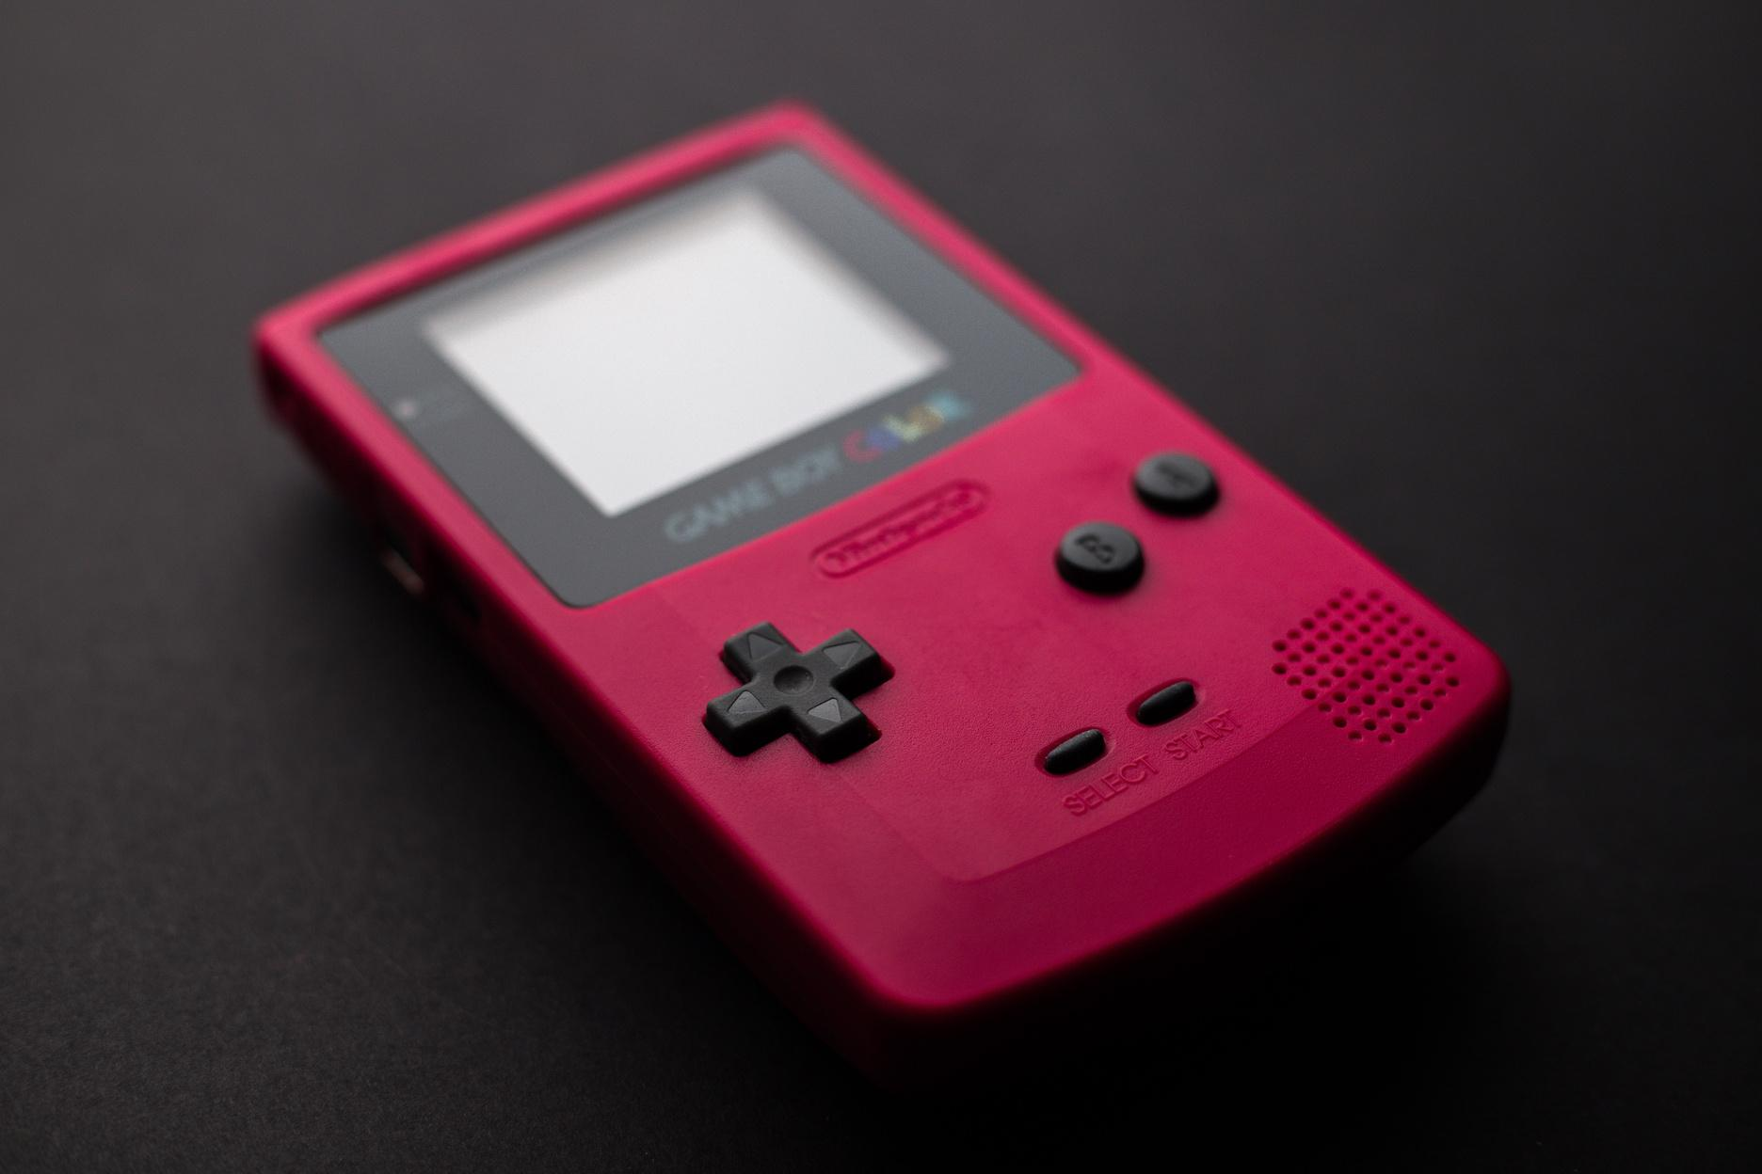
Gallery Image
What can you say about your projects? Share it here!

Slide 47
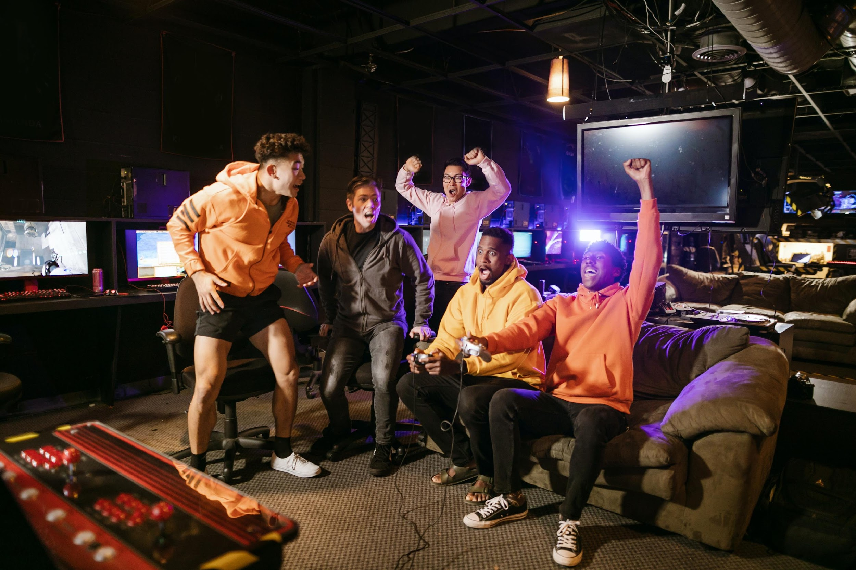
Subscription Plan
20$
30$
300$
MONTHLY
MONTHLY
YEARLY
Add a feature
Add a feature
Add a feature
Add a feature
Add a feature
Add a feature

Slide 48
About Me
Elaborate on what you want to discuss.

Slide 49
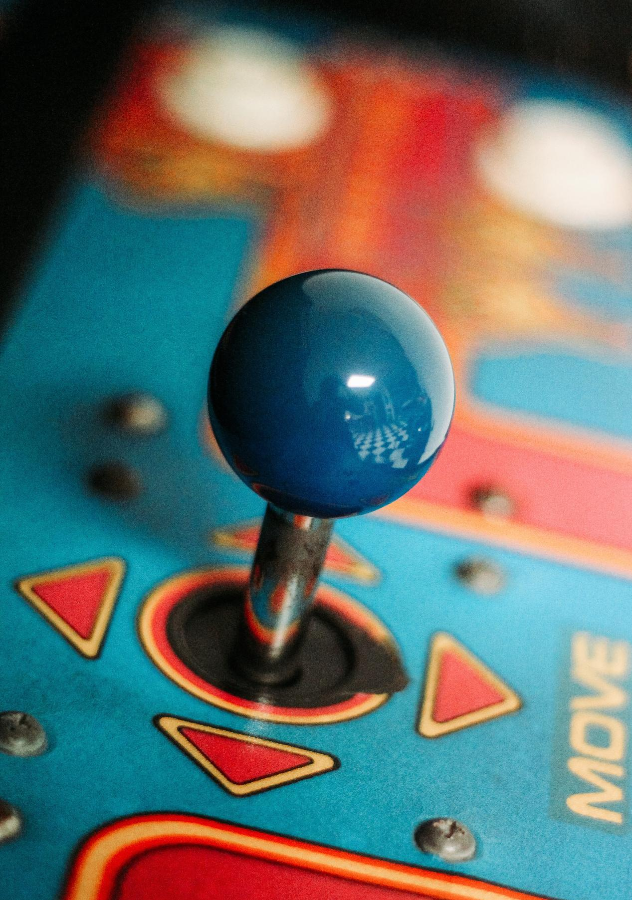
Our History
Presentations are communication tools that can be used as demonstrations, lectures, speeches, reports, and more. It is mostly presented before an audience.

Slide 50
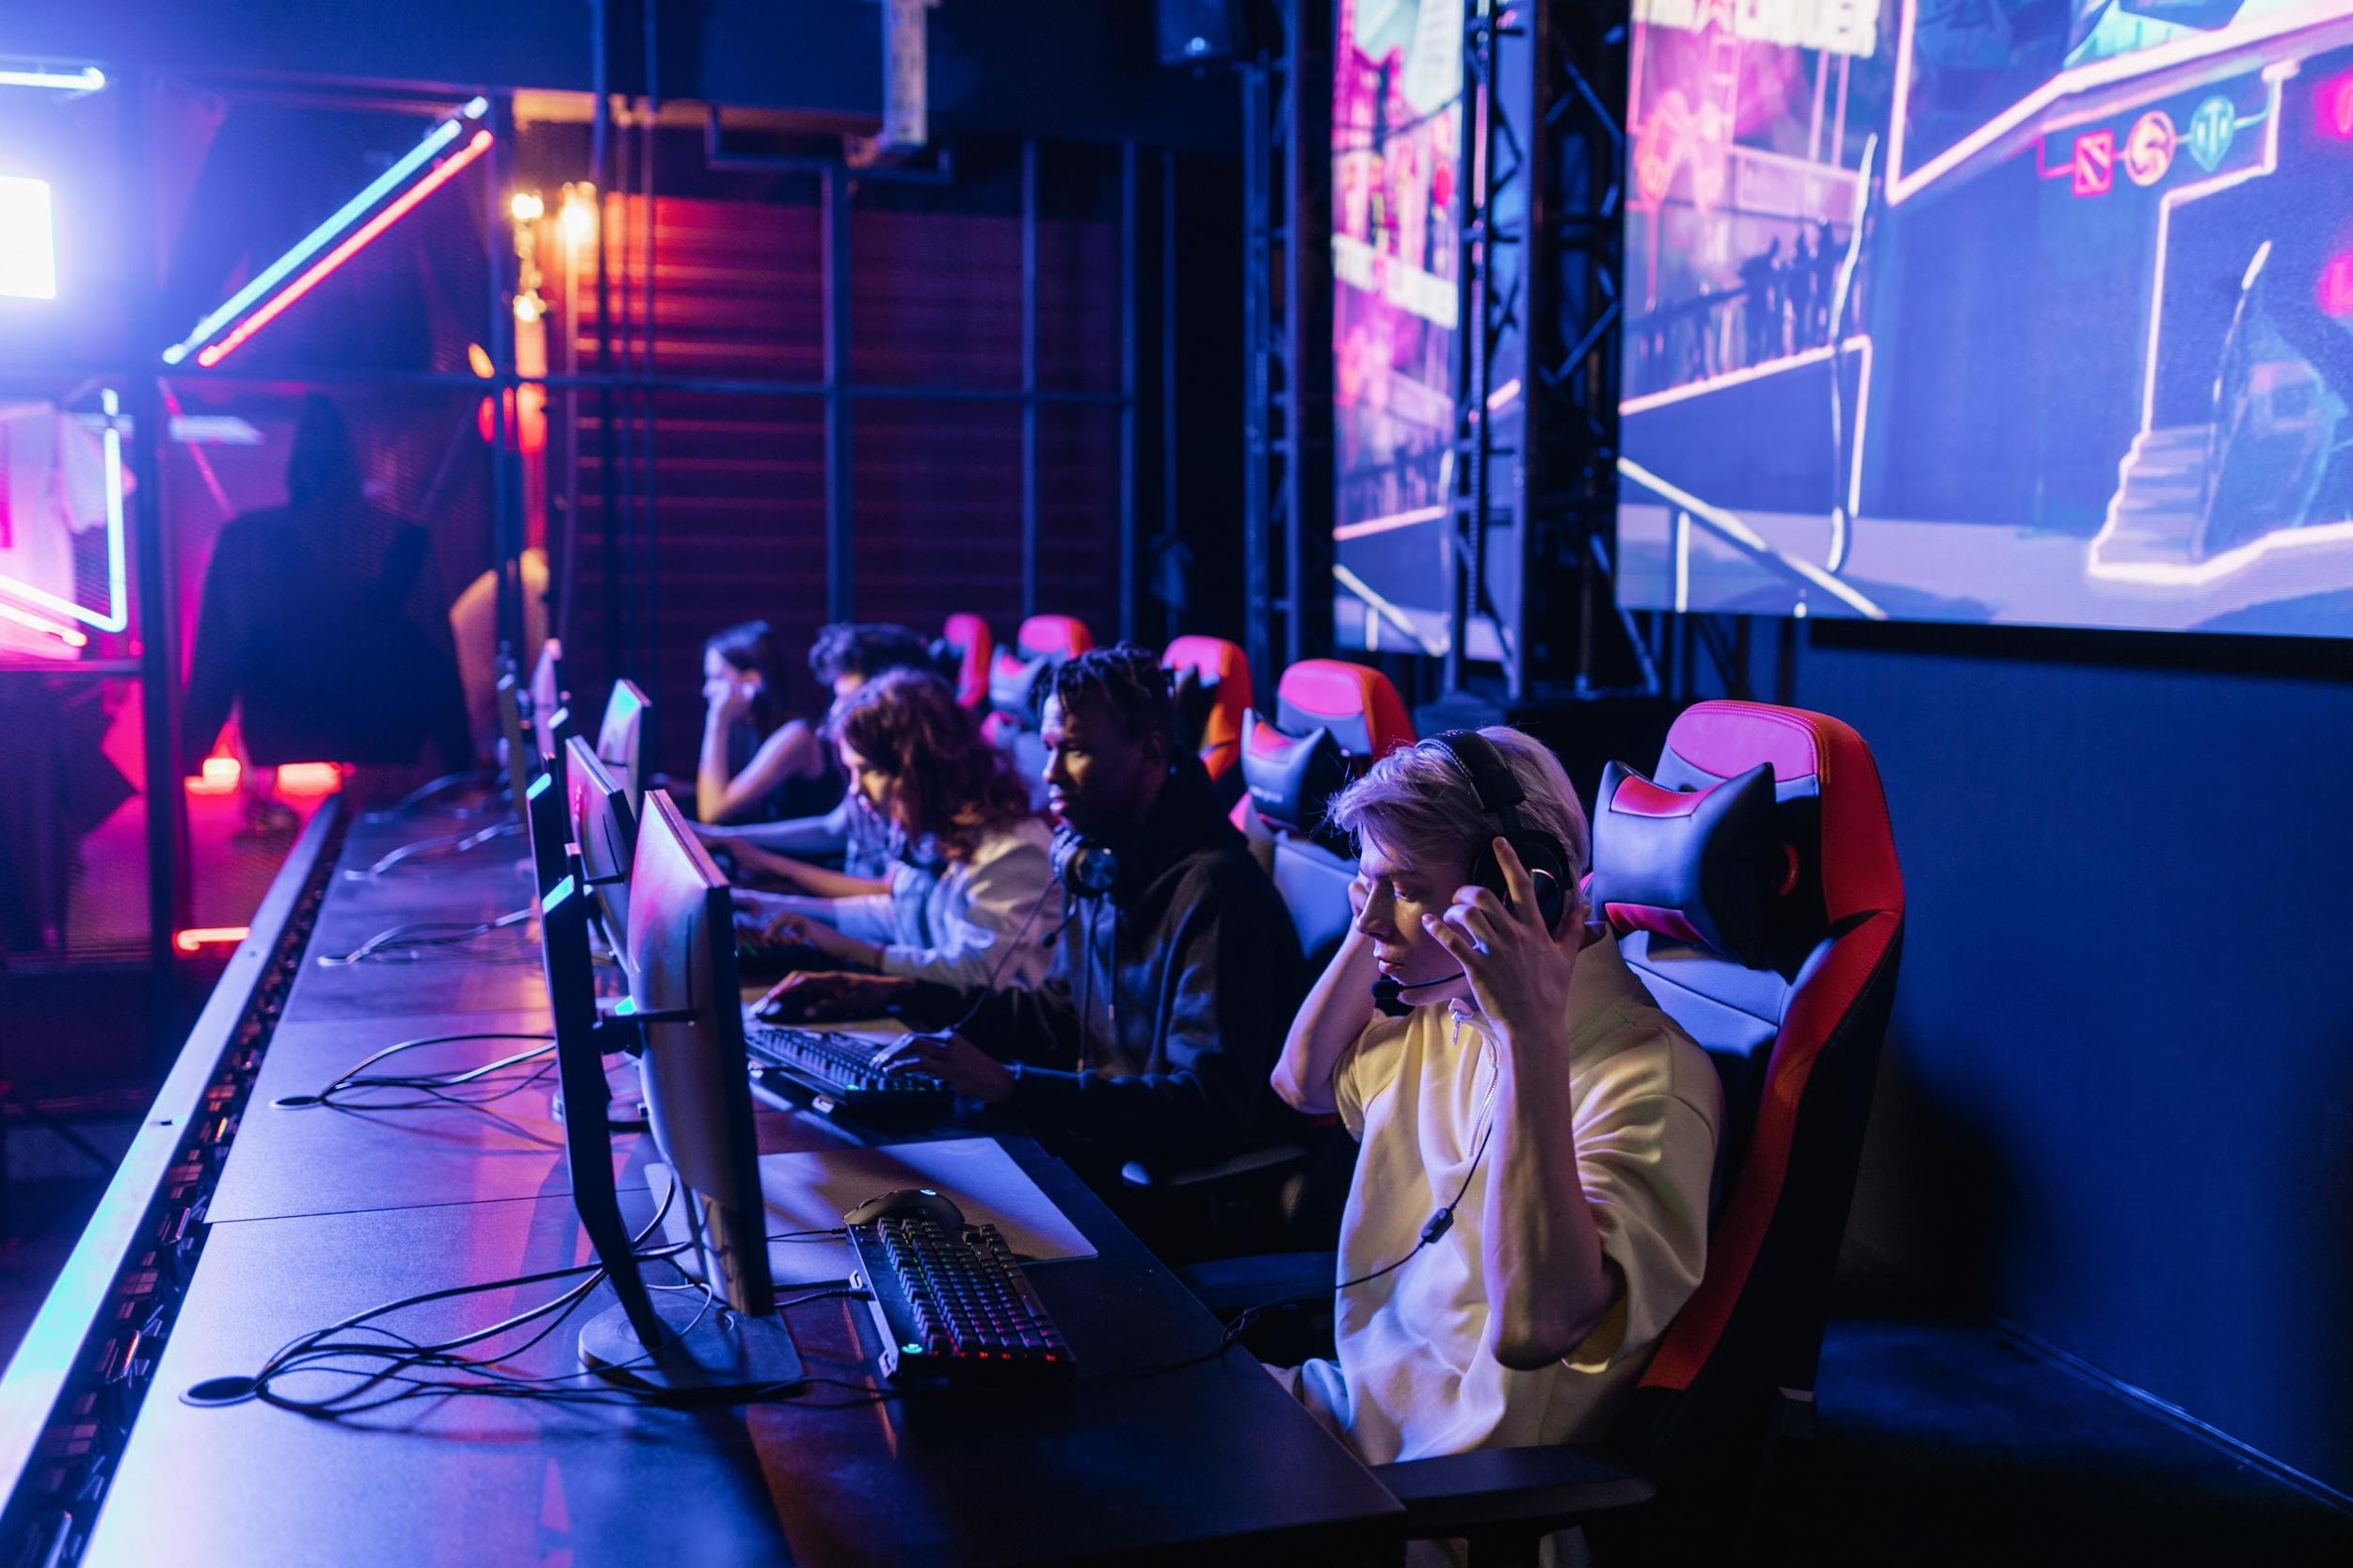

Write an original statement or inspiring quote
— Include a credit, citation, or supporting message

Slide 51
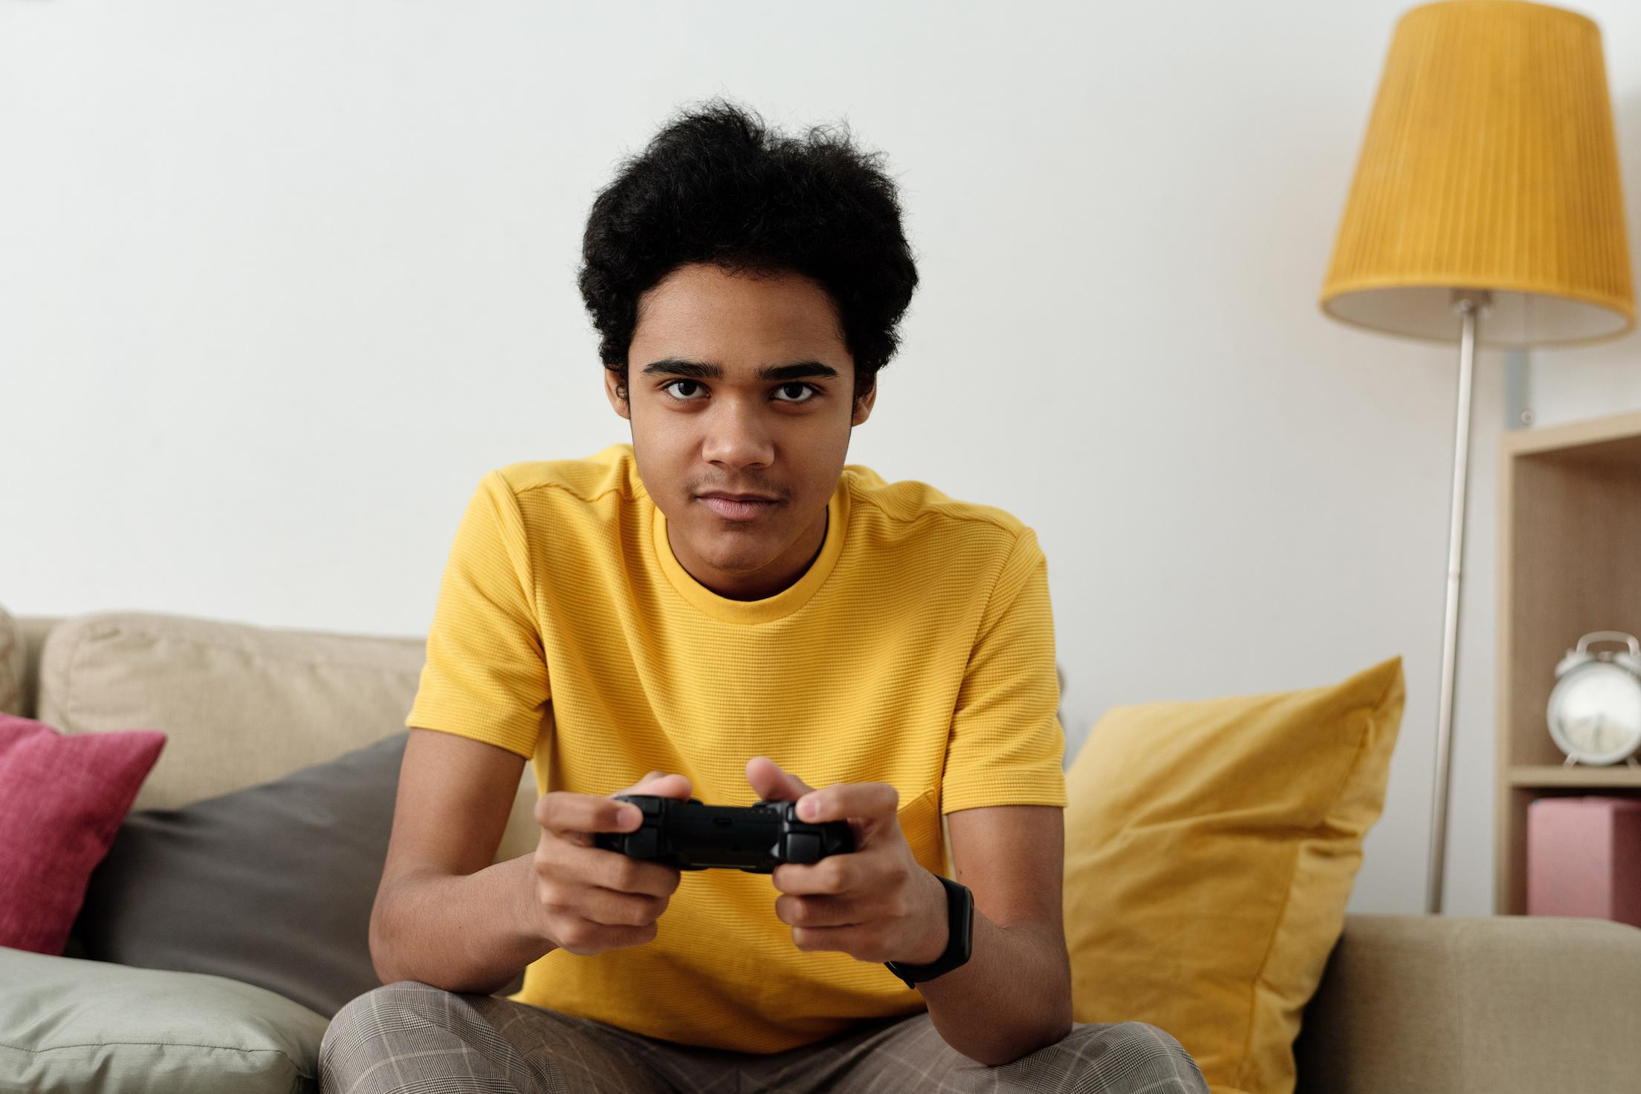

Our Founder
Name Surname
Presentations are communication tools that can be used as demonstrations, lectures, speeches, reports, and more. It is mostly presented before an audience.

Slide 52



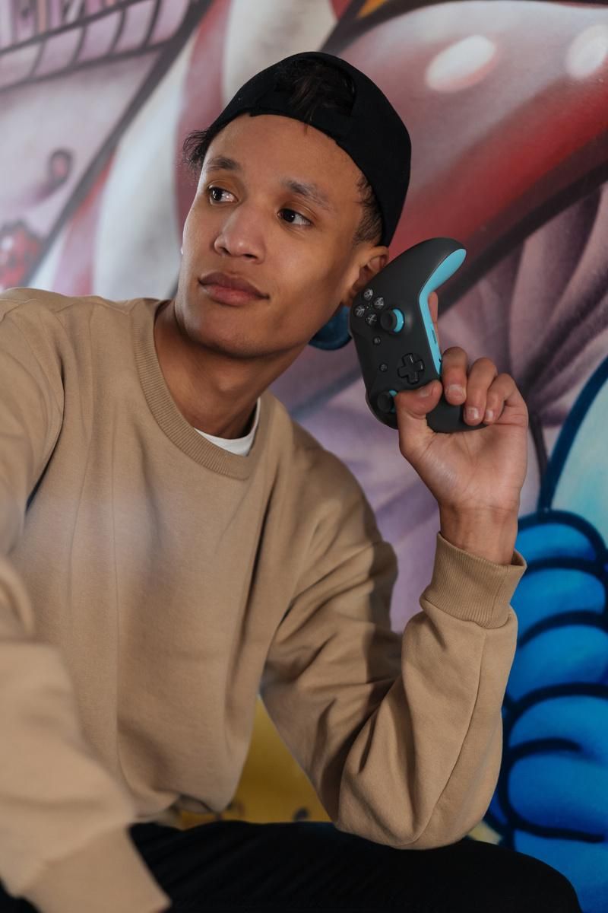
Testimonials
Client name
Client name
Client name
Elaborate on what you want to discuss.
Elaborate on what you want to discuss.
Elaborate on what you want to discuss.

Slide 53
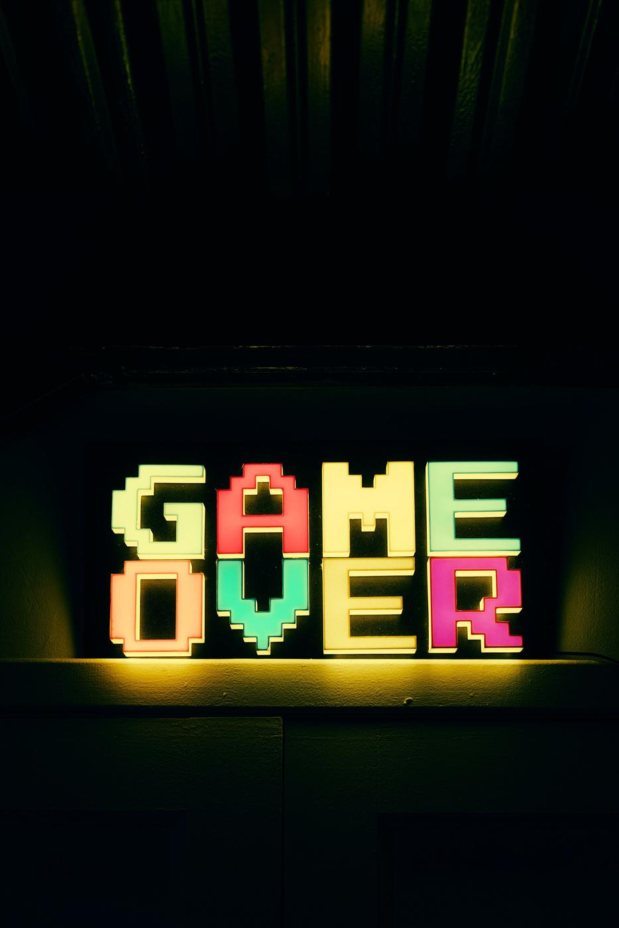
Thank you!
Write a closing statement or call-to-action here.

Slide 54
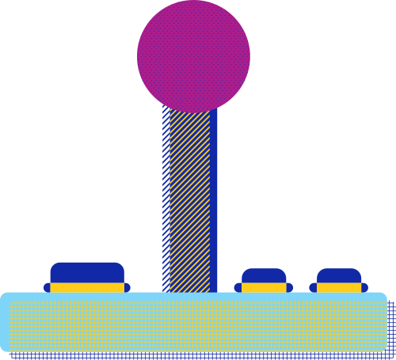






Resource
Page
Use these design resources in your Canva Presentation.
You can find these fonts online too. Happy designing!
Don't forget to delete this page
before presenting.
This presentation template uses the following free fonts:
Titles: Black Ops One, Disket Mono, Yeseva One
Headers: Black Ops One, Disket Mono
Body Copy: Stadio Now Monolinea
START

Slide 55



Credits
This presentation template is free for everyone to use thanks to the following:
SlidesCarnival for the presentation template
Pexels for the photos
Happy designing!

